Slide 1
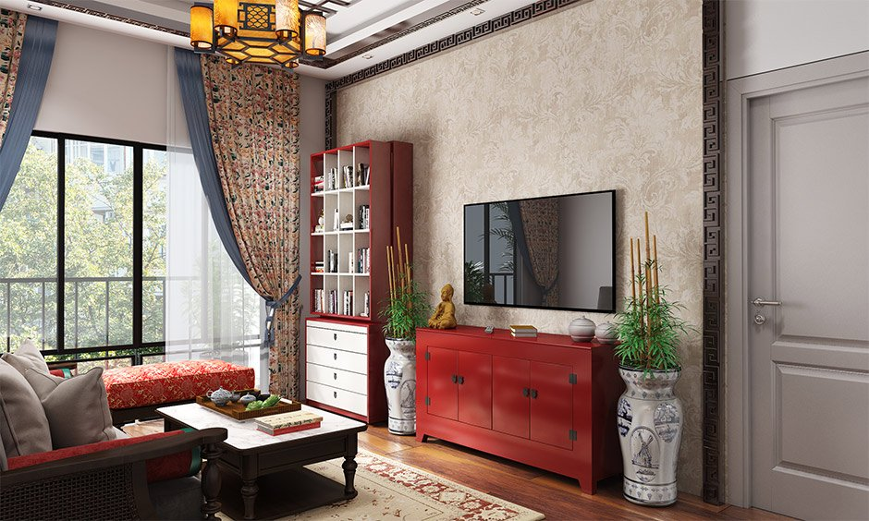

Slide 2
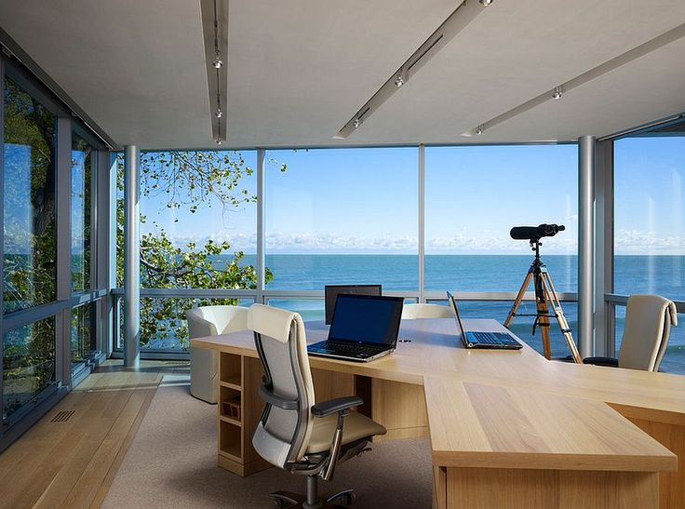

Slide 3


Slide 5
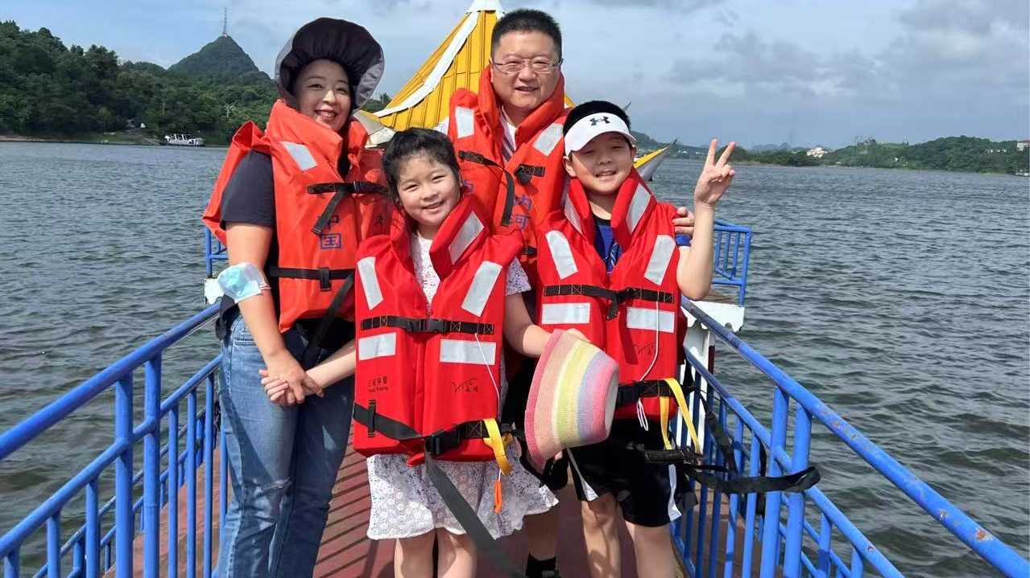
#BeYouRideBoats
#SafetyFirst

Slide 6
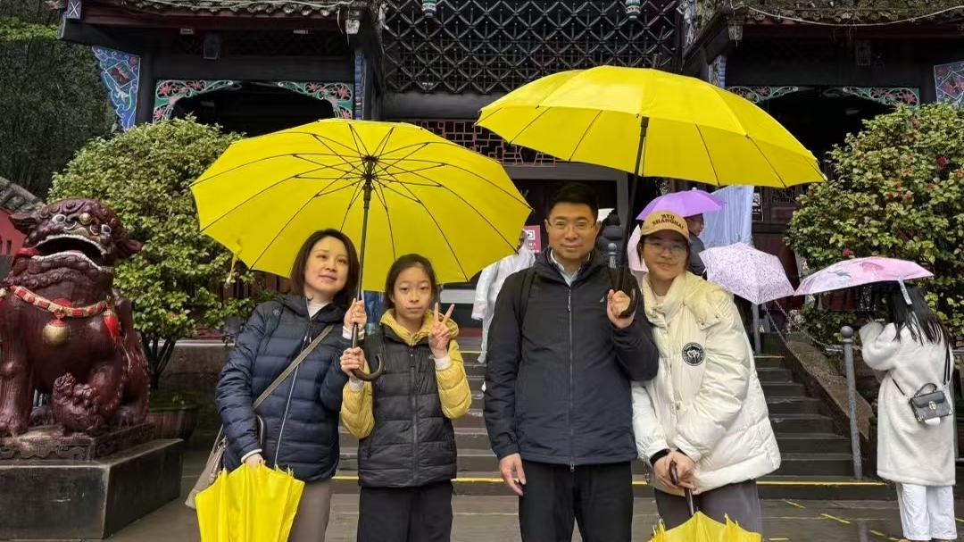
#BeYouLoveFamily
#TeamYellow

Slide 7
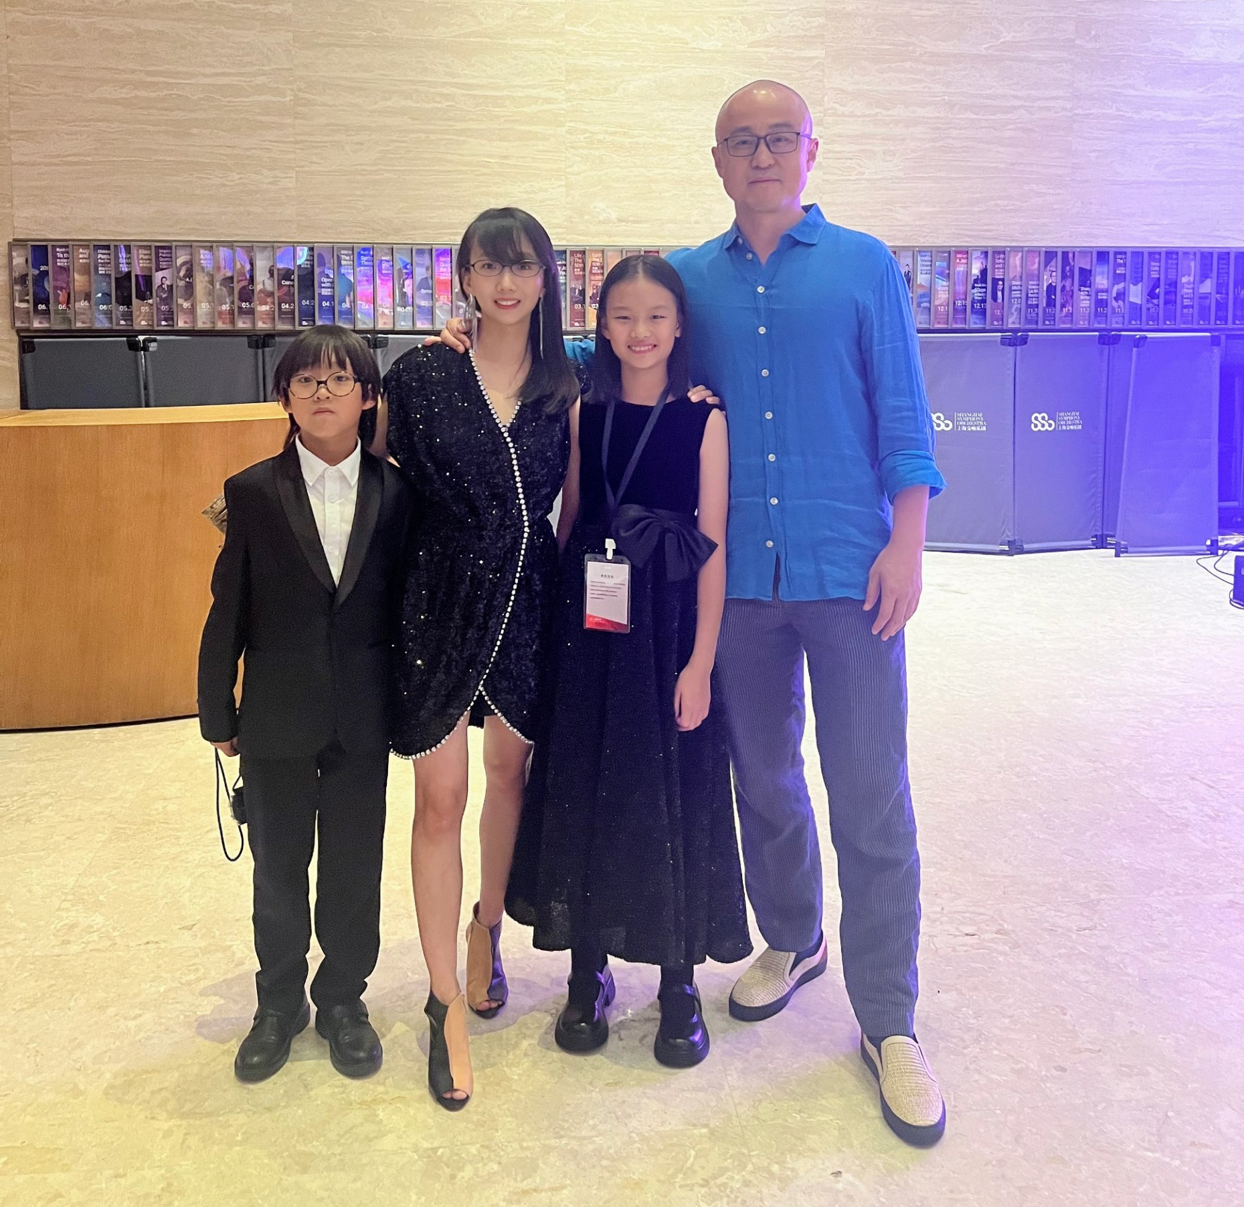
#BeYouPlayMore
#Violin

Slide 8
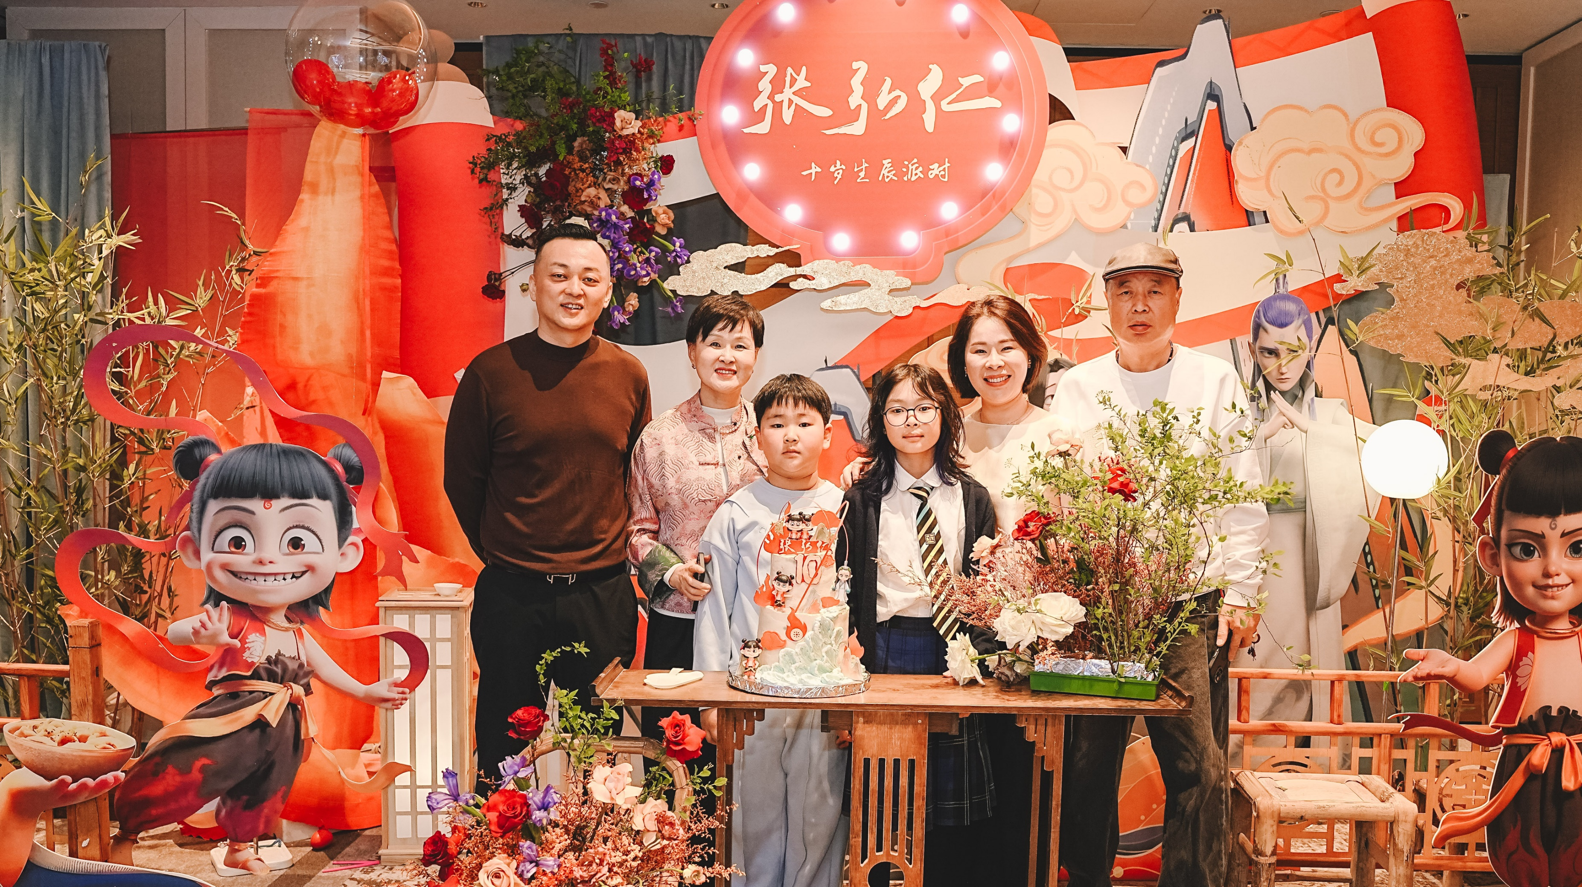
#BeYouEatCake
#WatchNezha2

Slide 9
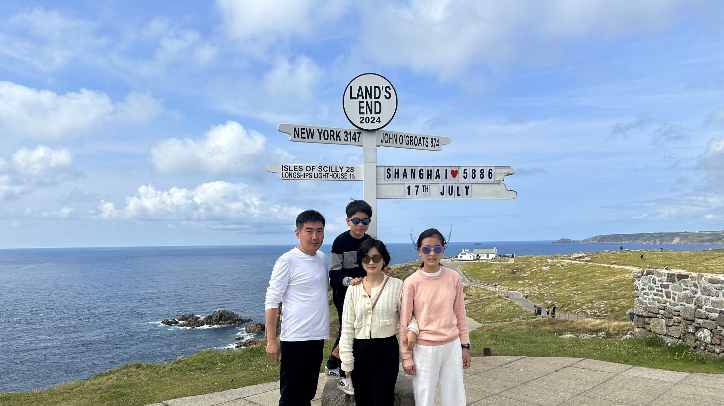
#BeYouLoveChina
#TeamTravel

Slide 10
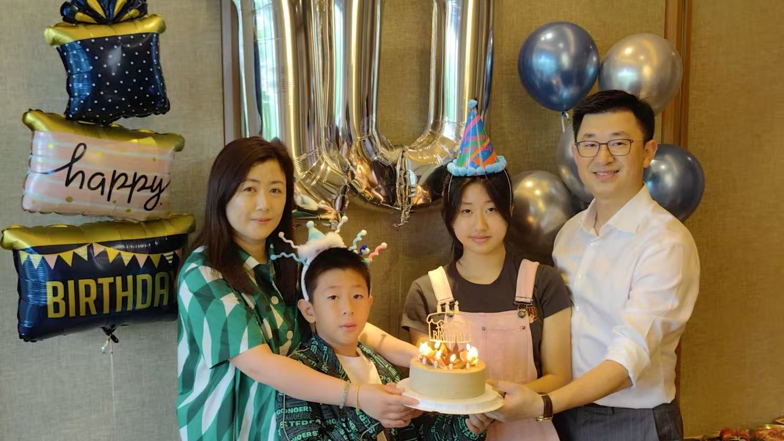
#BeYouLoveBirthdays
#Team10th

Slide 11
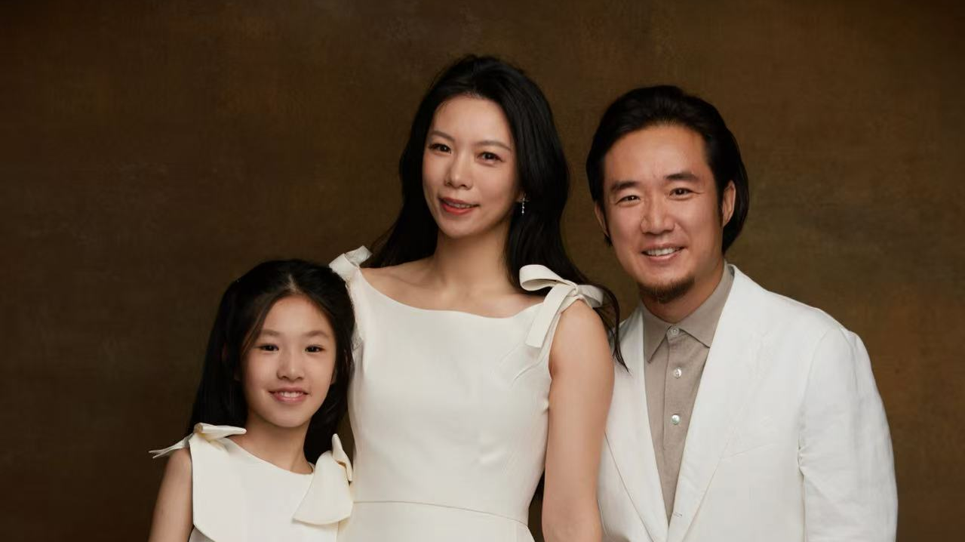
#BeYouBeMatching
#BeAFamily

Slide 12
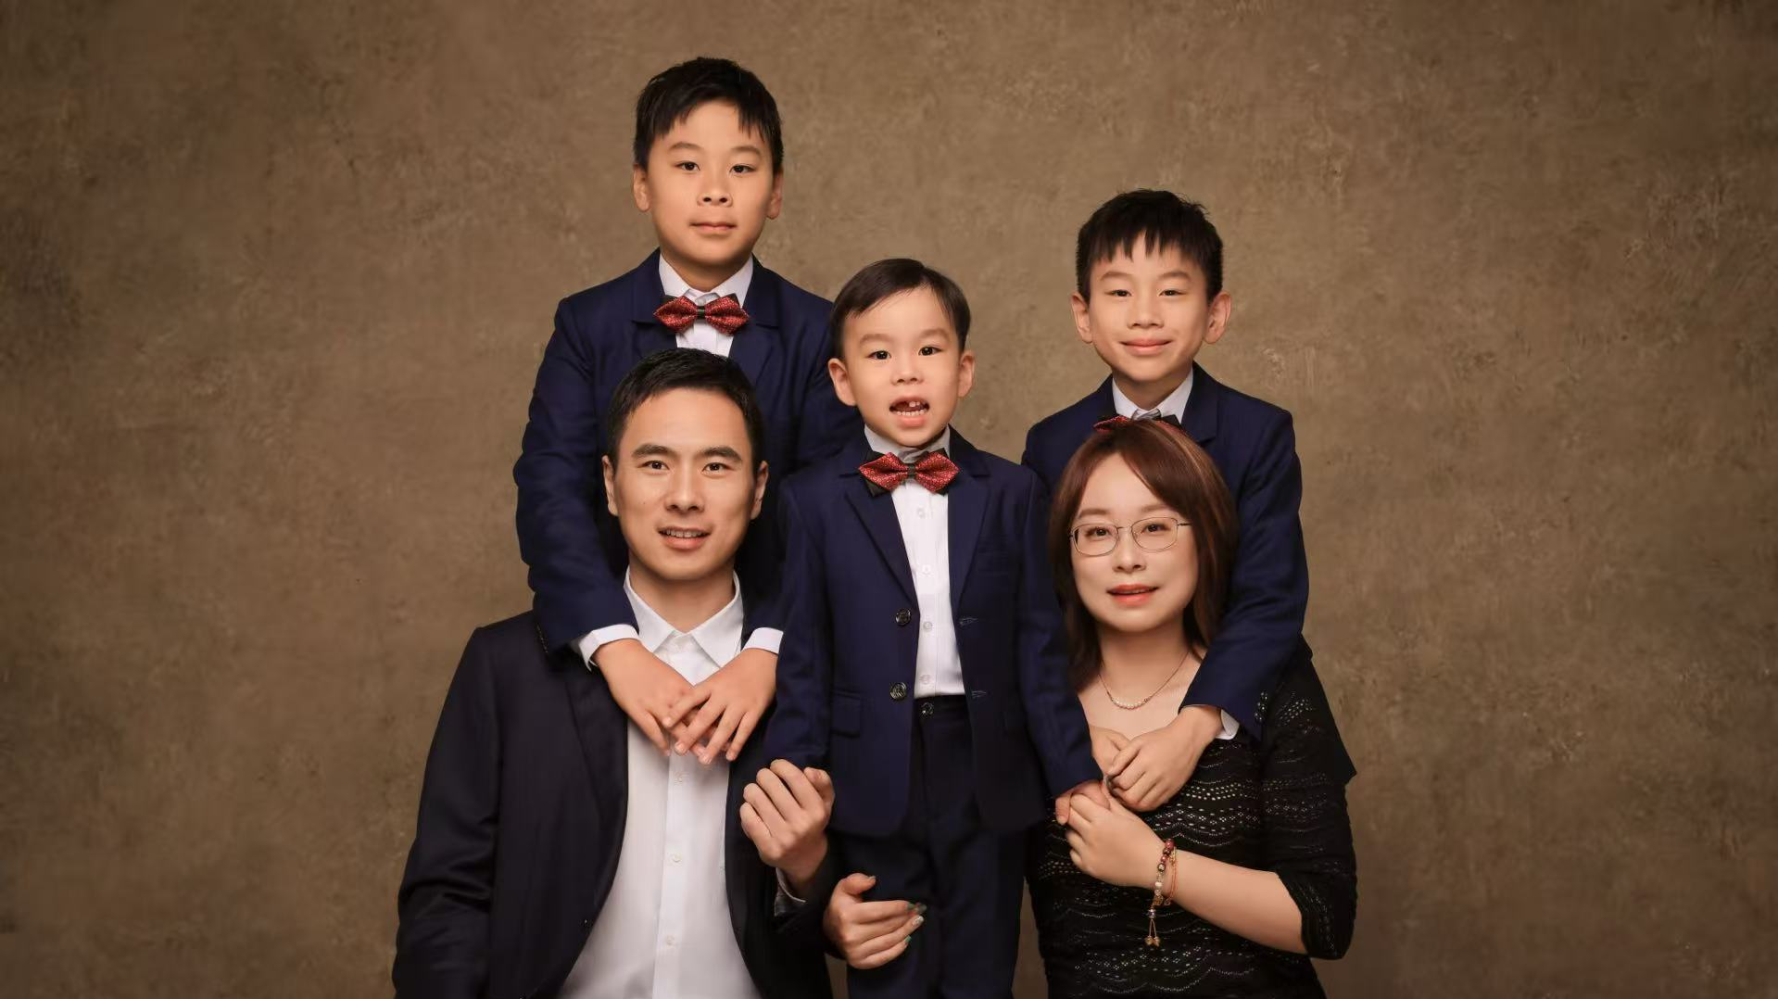
#BeYouBeSmart
#3Musketeers

Slide 13
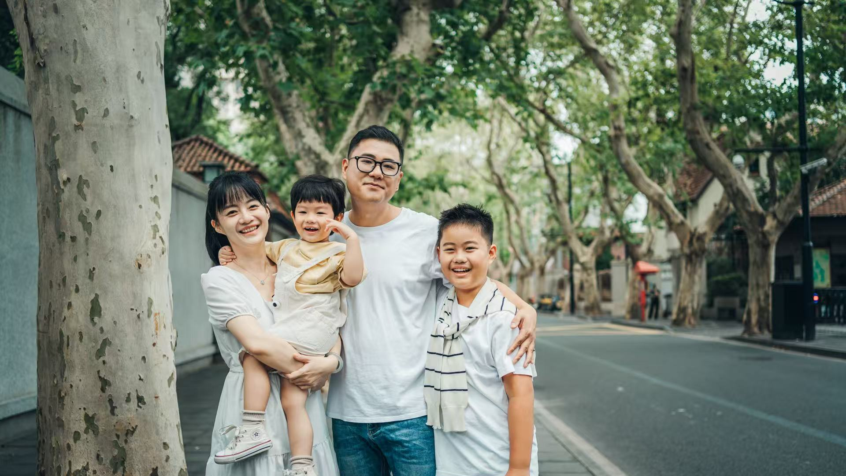
#BeYouSmileMore
#ShanghaiTravel

Slide 14
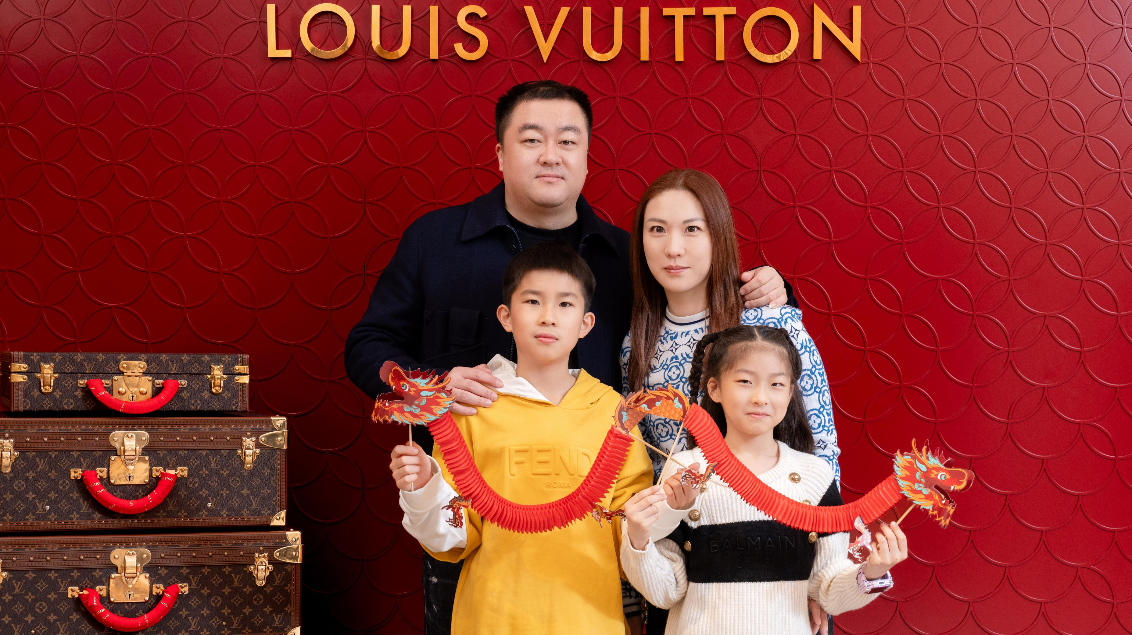
#BeYouLoveLV
#Money!!!!!!!

Slide 15
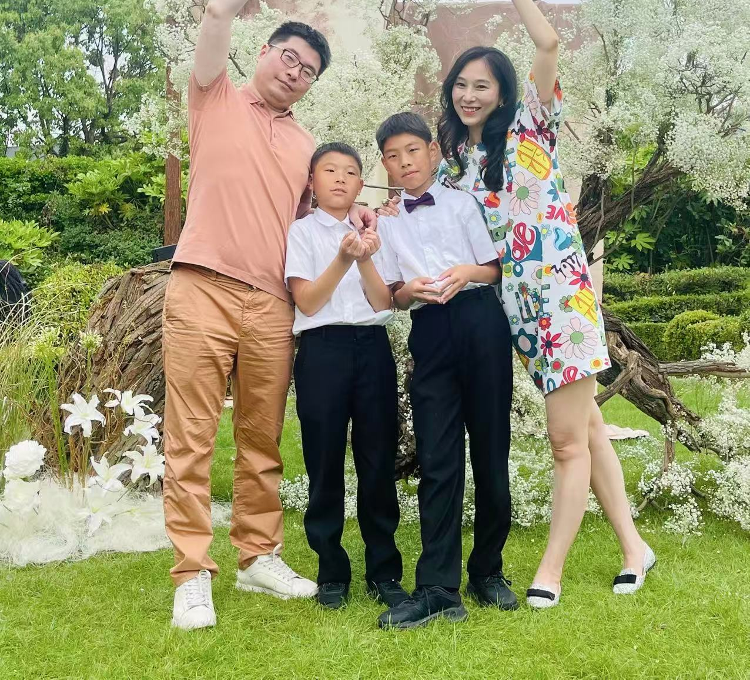
#BeYouPlayMore
#Flowers!

Slide 16
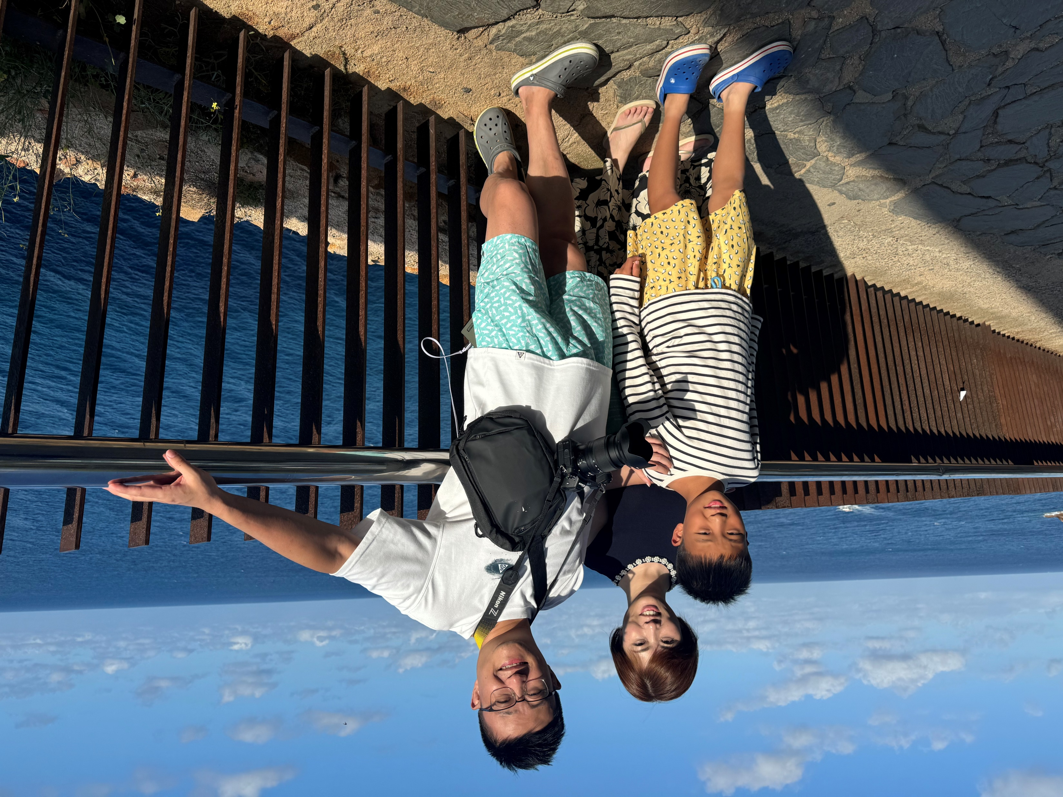
#BeYouLoveOcean
#TeamTravel!

Slide 17
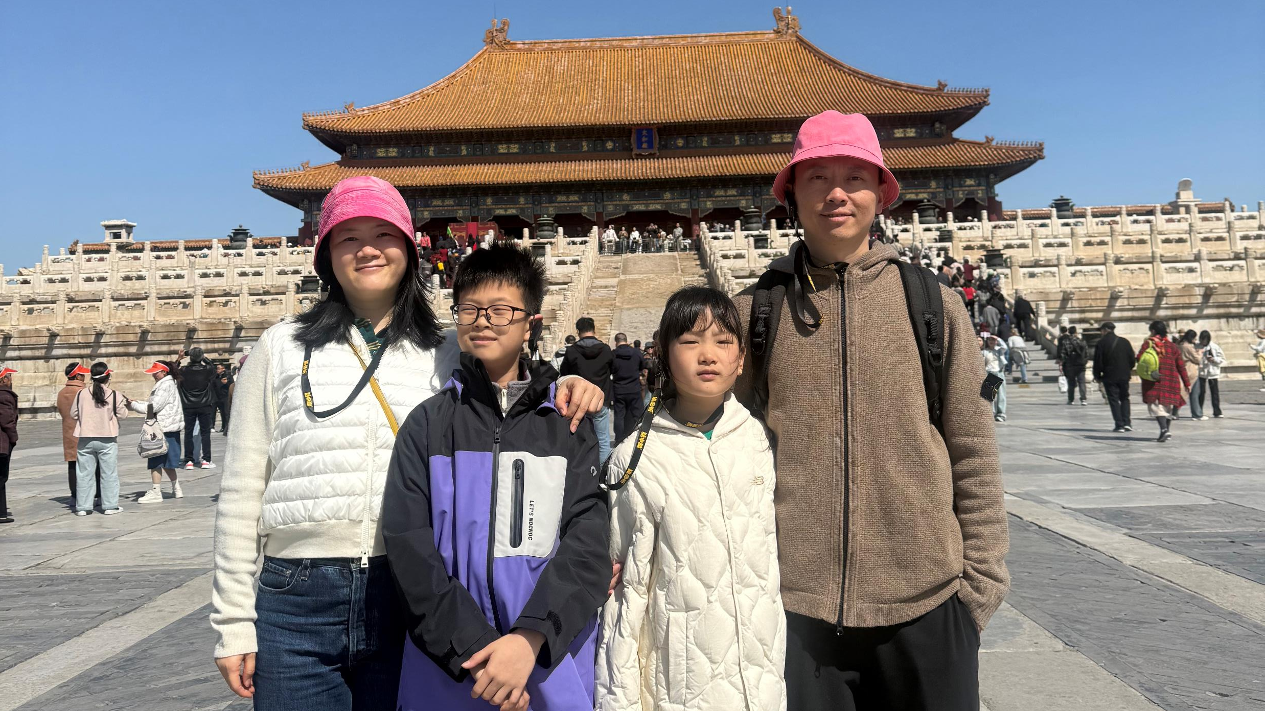
#BeYouExploreMore
#LoveBasketball

Slide 18
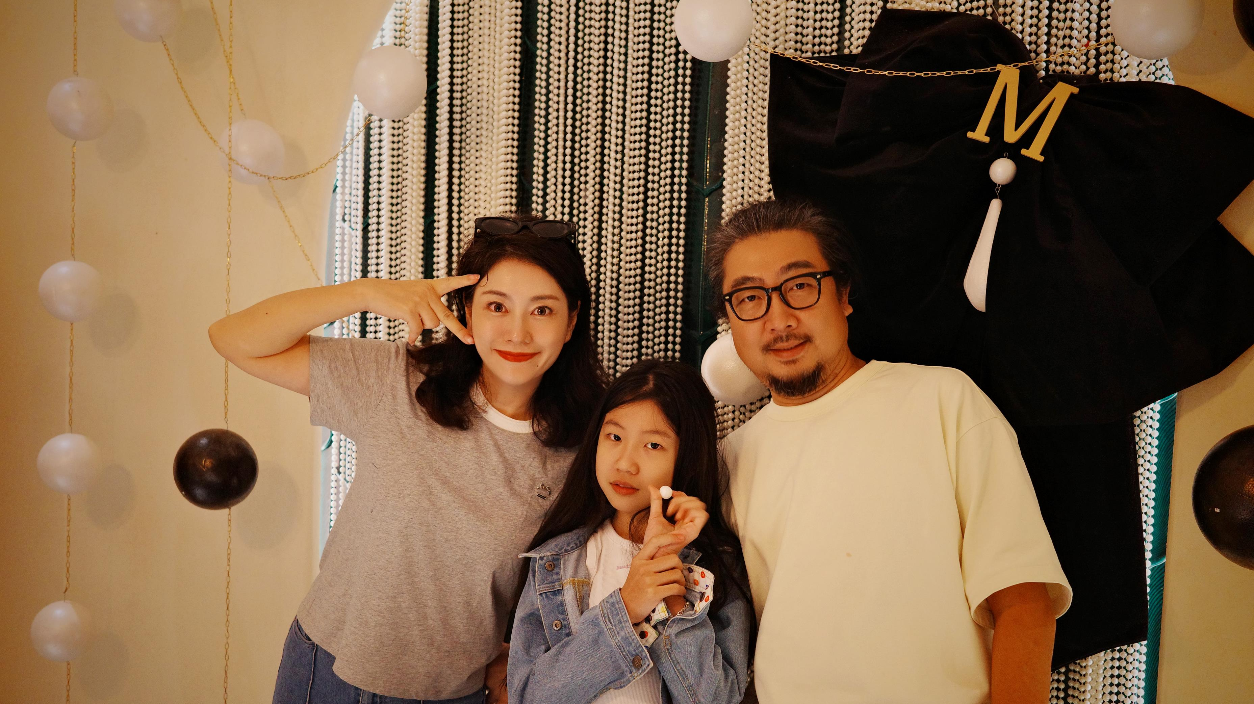
#BeYouBeHappy
#FamilyTogether

Slide 19
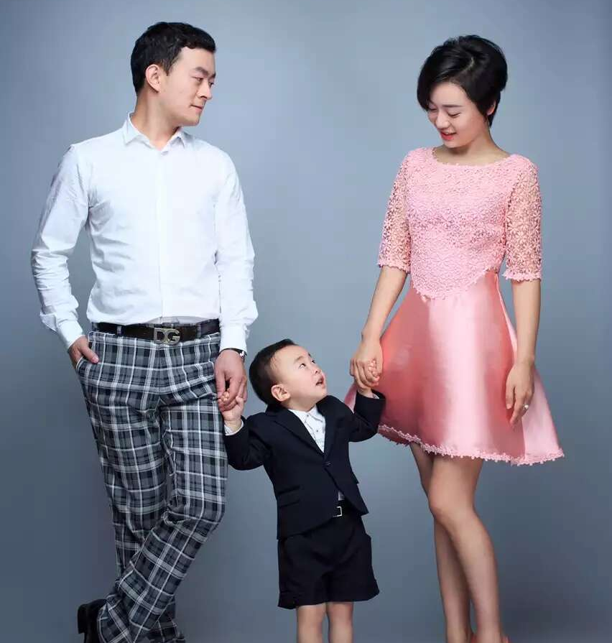
#BeYouGrowUp
#LittleBaby

Slide 20
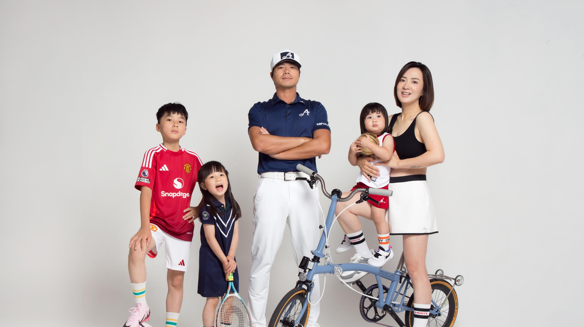

#BeYouLoveFootball
#Ronaldo
#Siu!!!!!!!!!!!!!!!!!!!!!

Slide 21
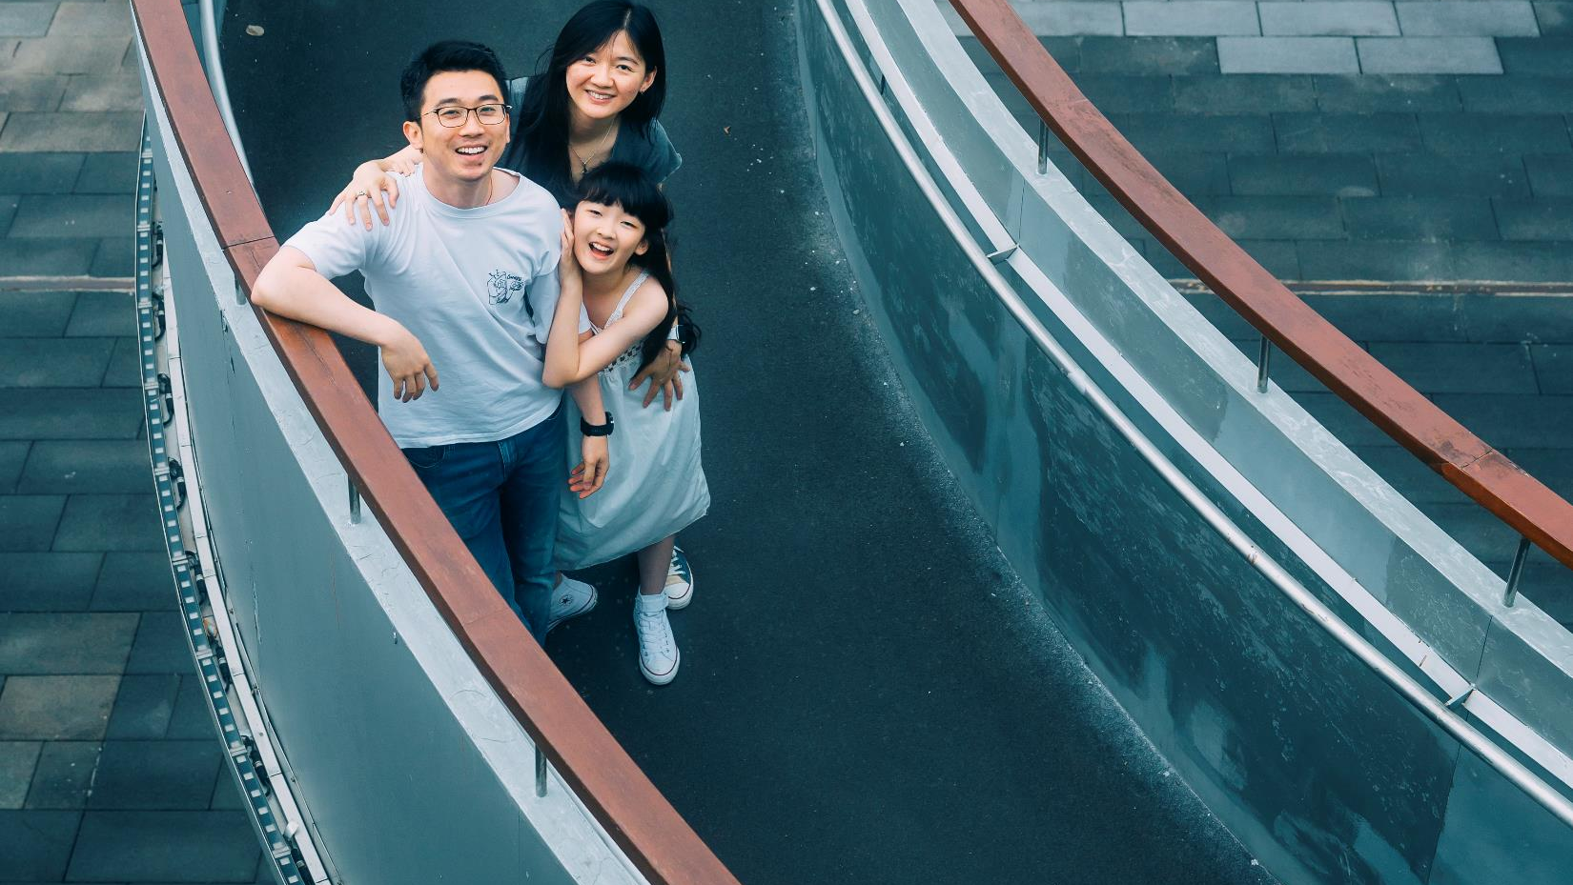
#BeYouLaughMore
#SpiralBridge

Slide 22
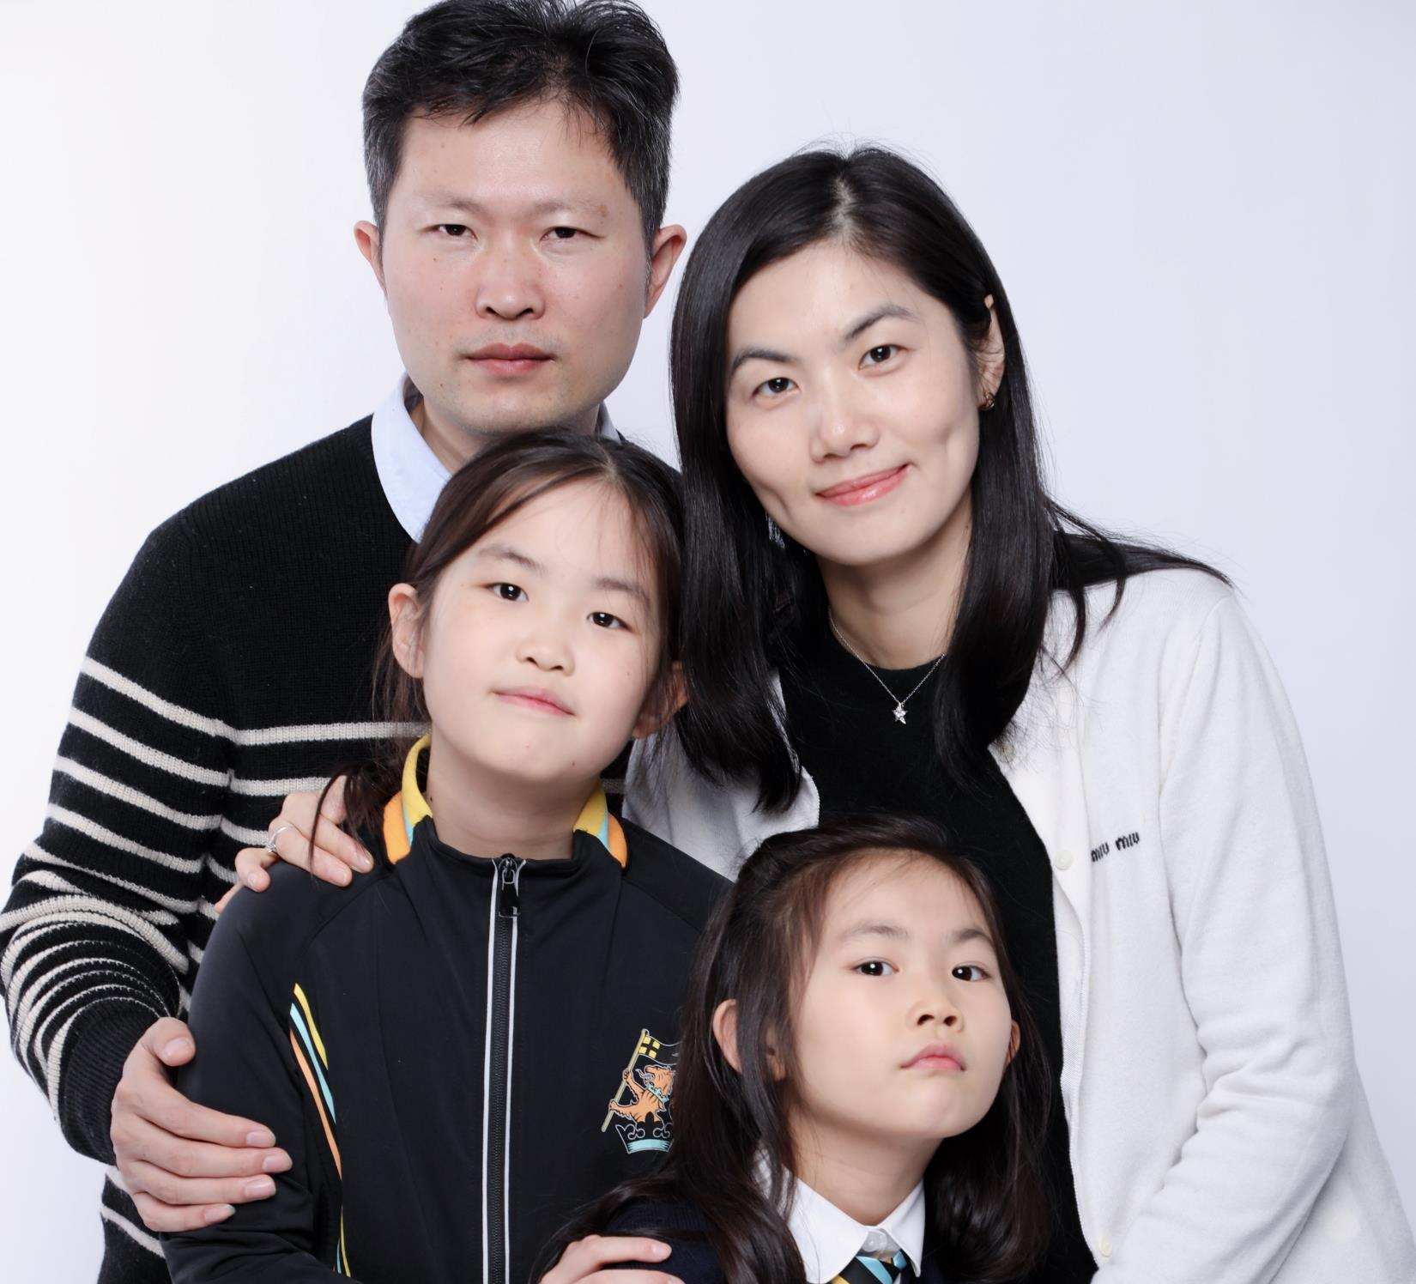
#BeYouBeFunny
#巴黎!!!!!!!!!!!!!!!!!!

Slide 23
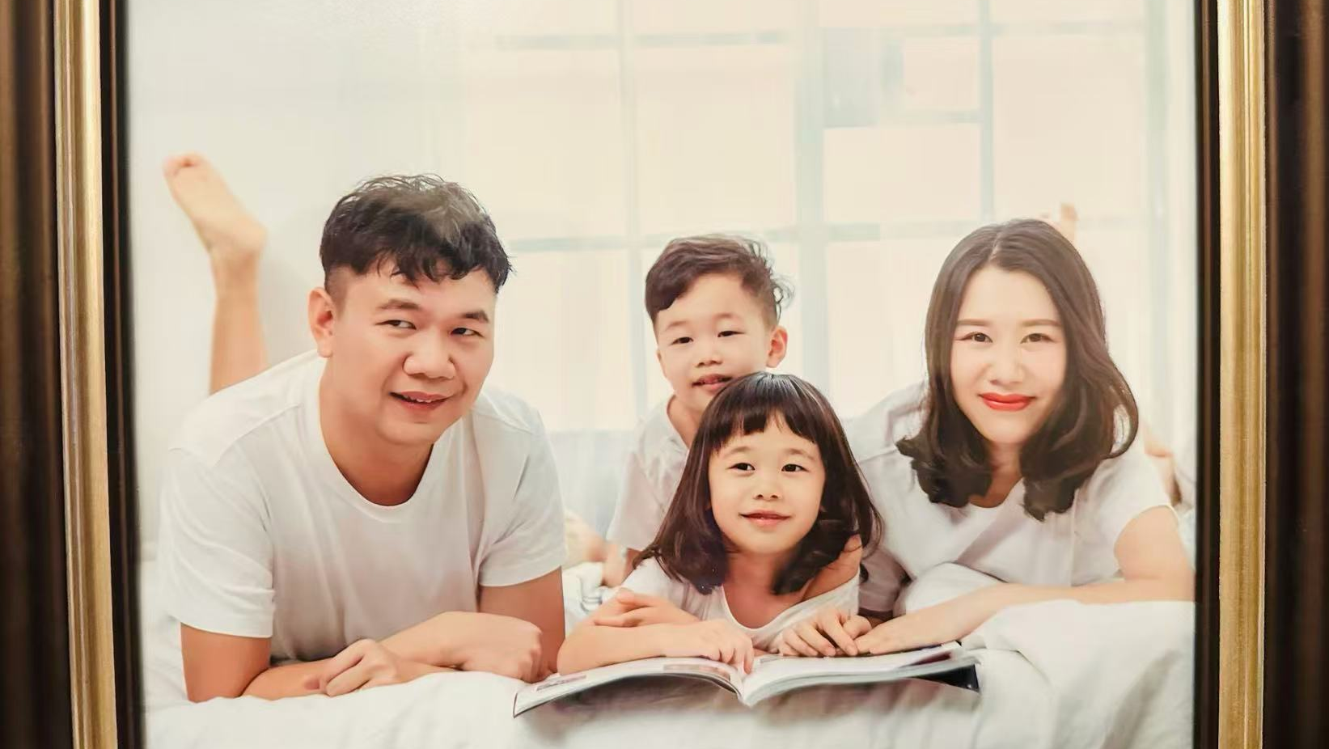
#BeYouReadBooks
#LearningKnowledge

Slide 24
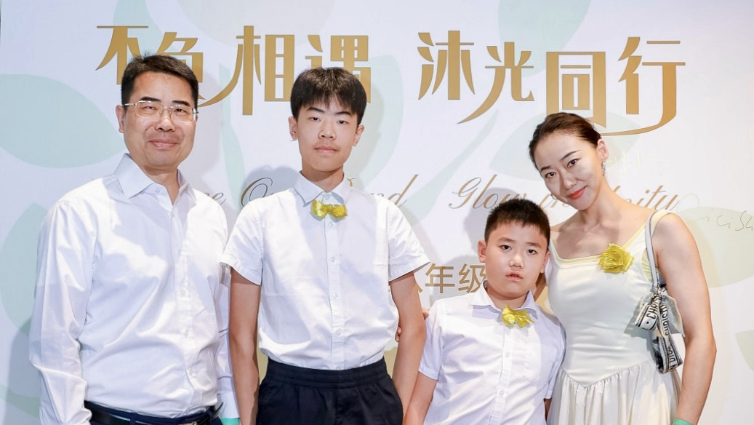
#BeYouBeFunny
#LearnMore

Slide 25

#BeYouThinkMore
#CPUGonnaExplode

Slide 26
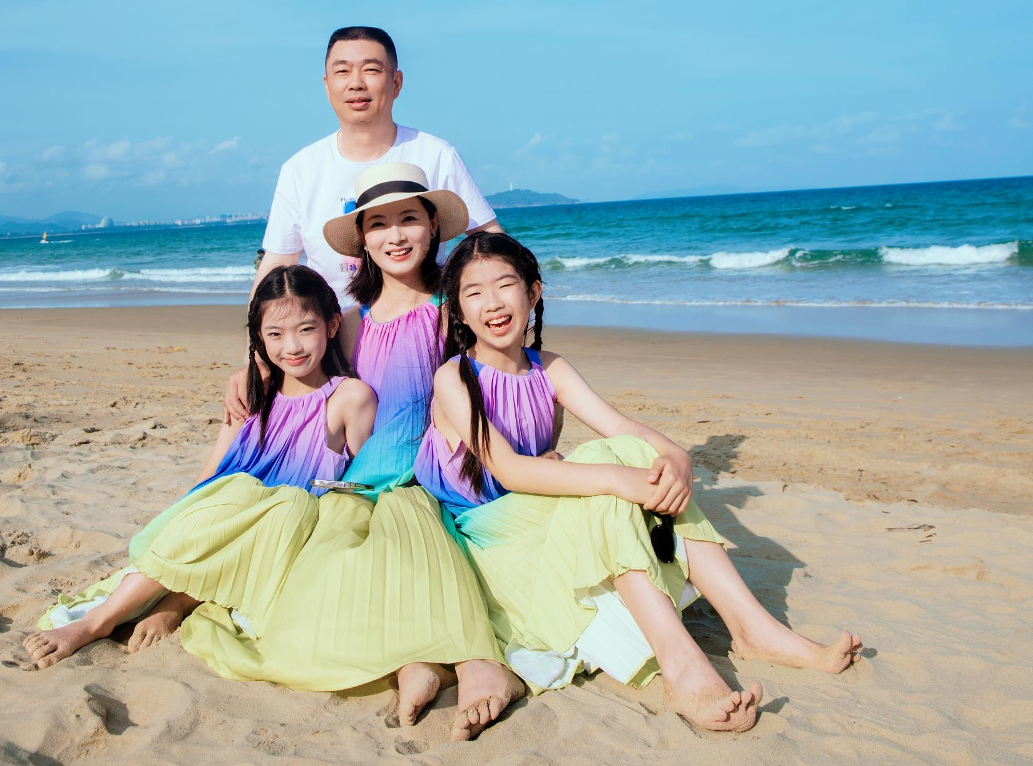
#BeYouTravelMore
#SunnyBeach

Slide 27
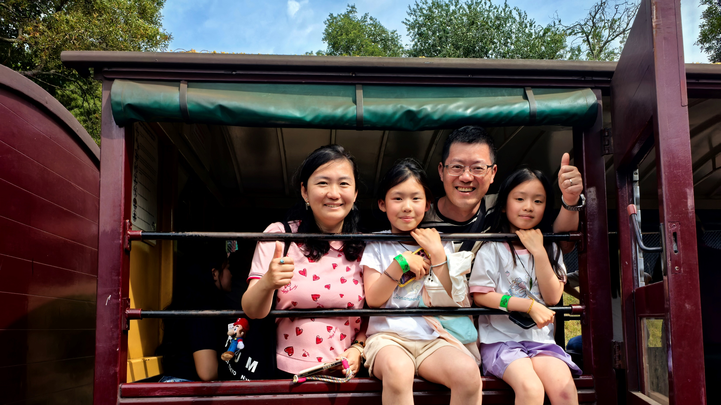
#BeYouRideTrain
#HappyTime

Slide 28
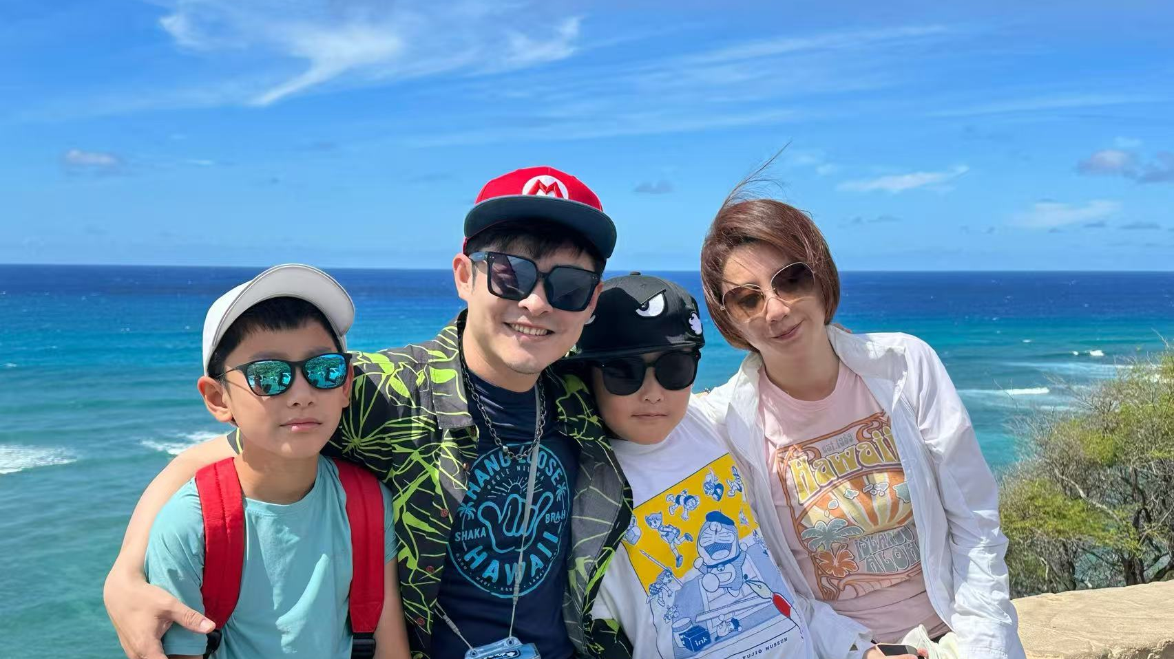
#BeYouWearSunglasses
#Hawaii

Slide 29


